Slide 1
Malignant Comments Classification
BY,
VIJAY RODRIGUES

Slide 2
PROBLEM STATEMENT:
The proliferation of social media enables people to express their opinions widely online.
However, at the same time, this has resulted in the emergence of conflict and hate, making online environments uninviting for users.
Although researchers have found that hate is a problem across multiple platforms, there is a lack of models for online hate detection.
Our goal is to build a prototype of online hate and abuse comment classifier which can be used to classify hate and offensive comments so that it can be controlled and restricted from spreading hatred and cyberbullying.

Slide 3
EDA STEPS / DATA PRE-PROCESSING DONE
Acquire the dataset
We have received this dataset from FlipRobo Technologies which is related to a Malignant Classification of comments on social media.
The sample data is provided to us from our client database. It is hereby given for this exercise.

Slide 4
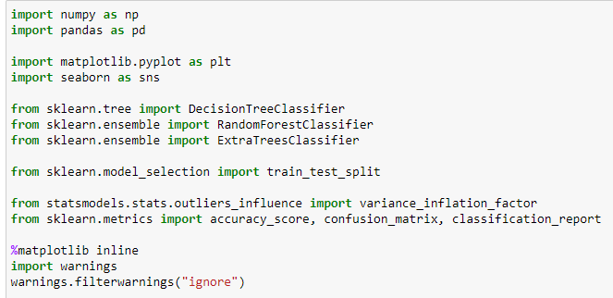
2. IMPORT ALL THE CRUCIAL LIBRARIES
For this project I have used the following major libraries like Pandas-profiling, Pandas, Matplotlib and Seaborn that are used for EDA or any other pre-processing done in this scenario.

Slide 5

3. IMPORT THE DATASET
The dataset is in CSV format and it is imported using Pandas library in Jupyter Notebook.
The statement pd. set_option("display.max_columns", None) simply allows us to physically see all the feature columns.
The statement pd. set_option("display.max_rows", None) simply allows us to physically see all the feature rows.
By default, Jupyter Notebook doesn’t display all the rows and columns at the same time and only selected portion from starting and ending of dataset are displayed.

Slide 6
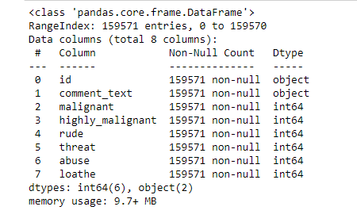
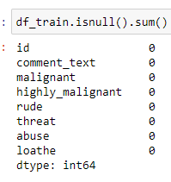
4. IDENTIFYING AND HANDLING THE MISSING VALUES
There are no missing values hence no actions have been taken

Slide 7
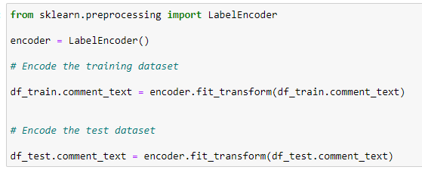
5. ENCODING THE CATEGORICAL DATA
I have used LabelEncoder as the data is categorical and is not ordinal in nature.

Slide 8
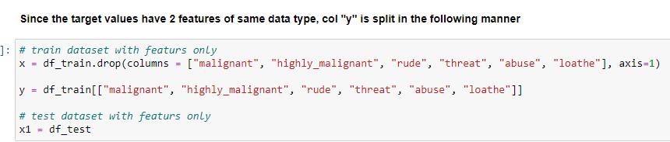

6. SPLITTING THE DATASET
Splitting up of dataset between x (features) and y (target column).
Split the dataset into train and test data set.
I have chosen 200 random state and 30% of data is divided in text dataset.

Slide 9
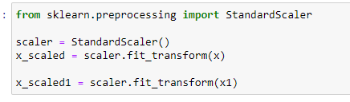
7. FEATURE SCALING AND STANDARDIZATION
Finding variance inflation factor in each scaled column
This gives us relationship between feature vs feature and we can drop if necessary to avoid multicollinearity.
From the below observation, I have not considered this step.
Also without dropping the features I got even better accuracy in the final model.
Let’s us now Scale the data for further processing.
we have used StandardScaler for further scaling up of data

Slide 10
ASSUMPTIONS CONSIDERED
Perform proper data cleaning and text exploration.
Focus on data visualization and infer details from it.
Try to infer unique patterns from the data and try to generate new features.
Use 4-5 models for training, do proper hyperparameter tuning and choose the right evaluation metrics to finalize your model.
Test your predictions on multiple metrics like log loss, Recall and Precision.
Create a detailed report mentioning all the steps in the format of a sample documentation file.
Create a powerpoint presentation of the project.

Slide 11
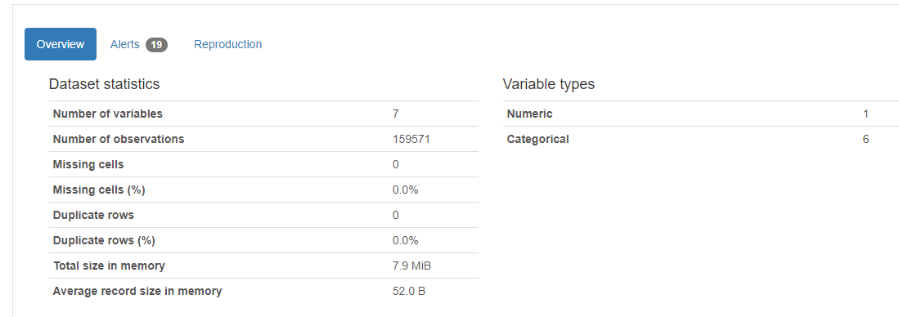
Visualizations
The following figure gives us the total count or shows us the overview of the dataset itself.
All the attributes such as variables, observations, how many are numerical and categorical etc are all displayed using this figure.

Slide 12
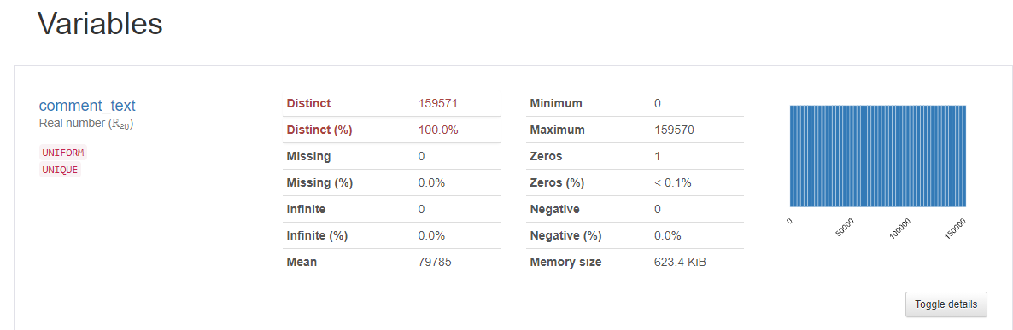
By toggling as mentioned we get to see the details of individual features / variables of the dataset.
The below figure gives us details on the variable “comment_text” and we can toggle within to get details of remaining features as well.

Slide 13
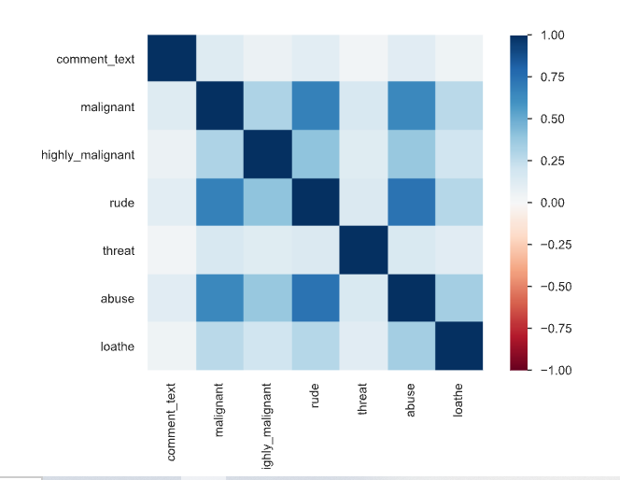
The below figure gives us details on the correlation matrix of the dataset and by default we have Pearson Correlation matrix.
But Pandas profiling lets us observe and compare other correlation methods also like Spearman’s, Kendall’s, Cramer’s and Phik Correlation.

Slide 14
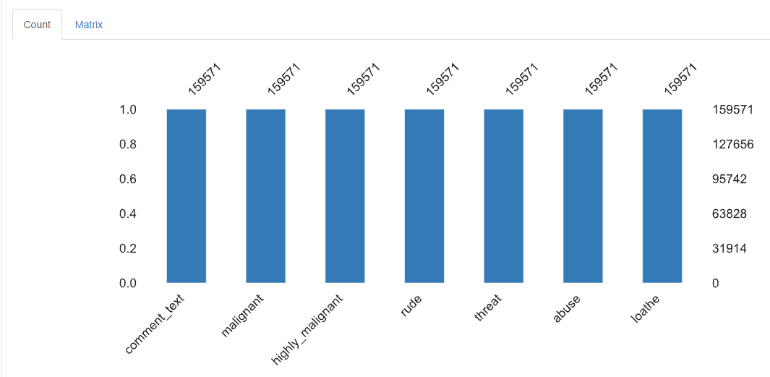
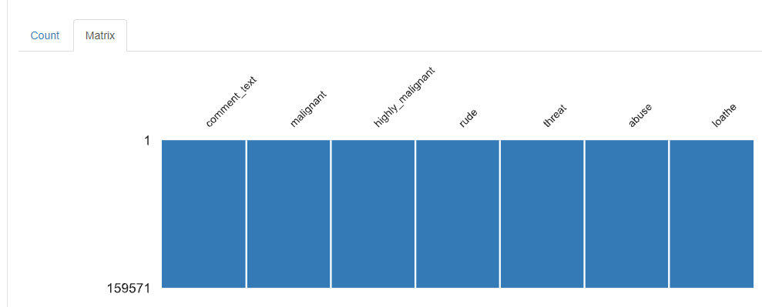
The following figure gives us both the count and matrix of missing values in the dataset if any.
In the following case we do not have any missing values.

Slide 15
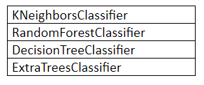
FOR THE MODEL BUILDING I HAVE CONSIDERED THE FOLLOWING 4 ALGORITHMS FOR THE TRAINING AND TESTING.

Slide 16
RUN AND EVALUATE SELECTED MODELS
I have used a total of 4 machine learning algorithms to find the best and suited model which also includes ensemble algorithms.
I have considered Accuracy Score for model evaluation.
But we cannot simply rely on these scores as we cannot have any scope for assumption. Hence post this I have also performed Cross Validation for all these algorithms to find the estimated performance metric when it’s actually used in production.
I have not used AUC ROC as it was not asked in the problem statement.

Slide 17
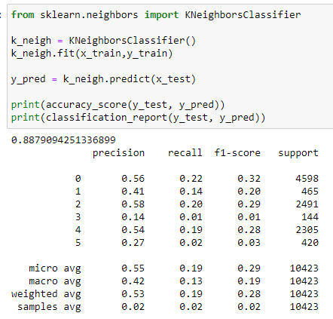
1) KNeighborsClassifier
From the below algorithm we can see the accuracy score for KNeighborsClassifier is approximately 88.79%

Slide 18
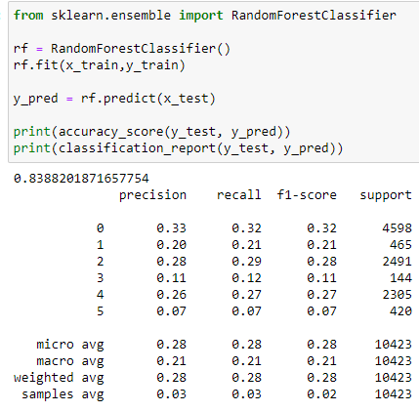
2) RandomForestClassifier
From the below algorithm we can see the accuracy score for RandomForestClassifier is approximately 83.88%.

Slide 19
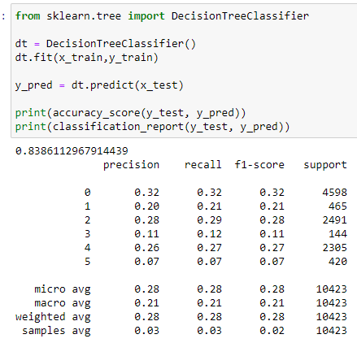
3) DecisionTreeClassifier
From the below algorithm we can see the accuracy score for DecisionTreeClassifier is approximately 83.86%.

Slide 20
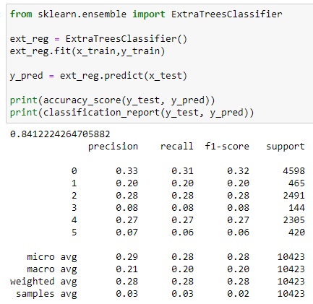
4) ExtraTreesClassifier
From the below algorithm we can see the accuracy score for ExtraTreesClassifier is approximately 84.12%.

Slide 21
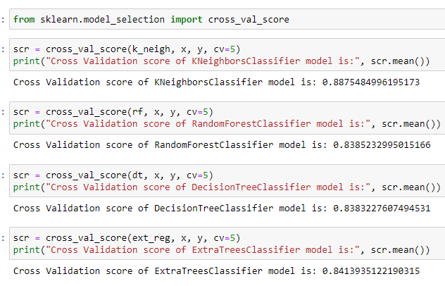
CROSS VALIDATION
The below code shows us the cross validation performed over all the algorithms and I have used the CV values as 5.
If you observe the below screenshot, we get the difference in the values.

Slide 22
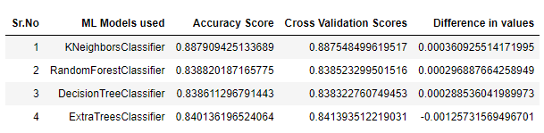
MODEL SELECTION
From the above algorithms ExtraTreesClassifier seems to be an ideal algorithm in this scenario and for this type of dataset.
The difference between the accuracy score and cross validation for this model is very less compared to other models.

Slide 23
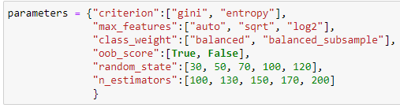
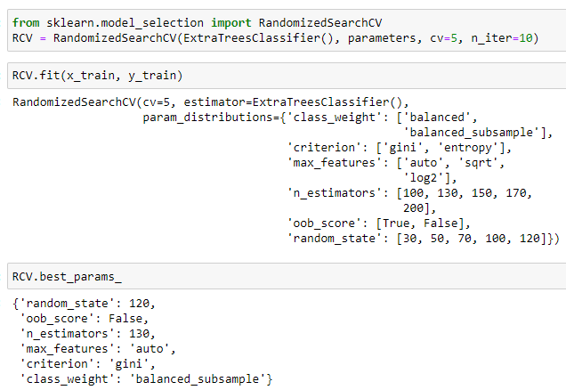
HYPERPARAMETER TUNING
Let us try to tune the proposed model (ExtraTreesClassifier) to get better accuracy, if possible.
The "parameters" have been selected from the skicit library and I have considered 6 parameters.
RandomizedSearchCV is used to tune the parameters by fitting the same to the training dataset and used the best parameters after selection.

Slide 24
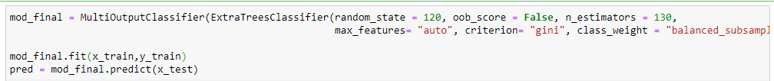
FINAL MODEL ( POST HYPERPARAMETER TUNING)
Rebuild the model using the appropriate params we received from best_params_

Slide 25
Key Findings and Conclusions of the Study
From the EDA , I could observe that it’s not easy to categorize the comments completely under the given malignant labels.
Majority of the comments are at times are just spam or only symbols that are neither malignant in any way nut it also doesn’t make any sense.

Slide 26
Learning Outcomes of the Study in respect of Data Science
With the help of this dataset, I was able to work on a single feature dataset.
I believe we can also proceed with neural network algorithms in such scenarios

Slide 27
THANK YOU…

